Slide 1
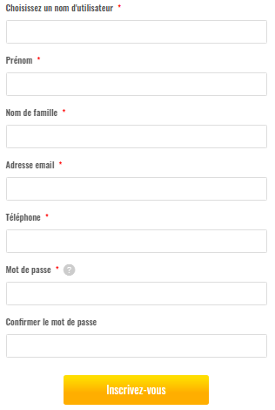
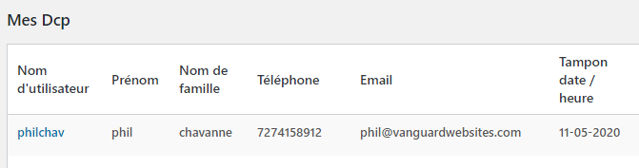
Two domain communication with each other (with free version)
Signup form for free version from main site (jedeposemonbilan.com)
As User will signup, the user info(username, first name, last name, email, mobile number) will also store in the secured site (jedeposemonbilan.info), and lawyer can check that in Mes-DCP Table
Mes-DCP page

Slide 2
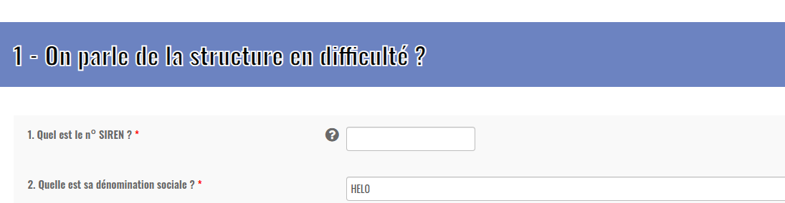
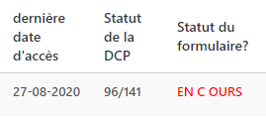
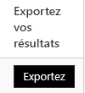
Mes-DCP Form
The data of Mes-DCP form from main site auto save after a fix time period. The form data saves in the secured site as well.
Last access date of form save in secure database
Status of DCP form, how many fields client has filled
Client will submit and complete the form and the form status will change to “FINIE”. This is how lawyer will get to know if a form is completed or not
Export button to download the pdf of Mes-DCP Form for the respective user

Slide 3
Two domain communication with each other (with paid version)
Signup form for paid version from main site (jedeposemonbilan.com)
As User will signup, the user info(username, first name, last name, email, mobile number) will also store in the secured site (jedeposemonbilan.info), and lawyer can check that in Mes-DCP Table
Stripe Payment

Slide 4
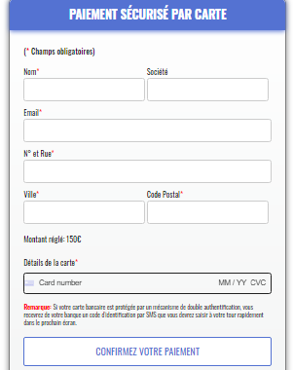
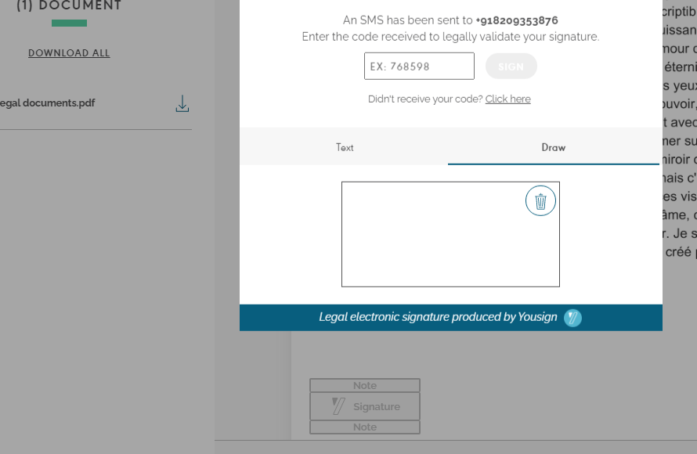
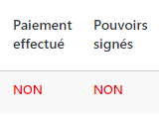
Redirect to Yousign Page
If client will pay, payment data save in database in secured database and the Payment status will change to OUI
Client need to sign on contract doc and the signed status will change to OUI in secured site Mes-DCP Table
Redirect to Mes-DCP Form

Slide 5
The data of Mes-DCP form from main site auto save after a fix time period. The form data saves in the secured site as well with time period.
Last access date of form save in secure database
Status of DCP form, how many fields client has filled
Client will complete the form and the form status will change to “FINIE”. This is how lawyer will get to know if a form is completed or not
Export button to download the pdf of Mes-DCP Form for the respective user

